Slide 1

Customer Retention
BY
Bhawana Maurya

Slide 2
INTRODUCTION
Business Problem
Customer satisfaction has emerged as one of the most important factors that guarantee the success of e-commerce store. It has been identified as a key stimulant of purchase, repurchase intentions and customer loyalty.
Background of the Problem
In this Fast paced world it has been evident that people want things at fingertip .It’s often seen that most of the customer in retails stores complain about lack of designs to choose from .This problem is more ardent in Tier 2 and Tier 3 cities in India ,where people had to choose between the limited choice they had .Thus there has been a sustainable gap in demand and supply of items to choose from and of course in a attractive price range . Ecommerce sites tend to bridge this gap by providing a plethora to choose from and in competitive price. As the Ecommerce boom happened, the bigger challenge for the E-commerce firms is to maintain the customer base for growing revenues as most of the business comes from loyal customers. Thus the key factor to a continued growth in this domain is recurring customer and their loyalty

Slide 3
Objective
The main objective of this Project is to identify the key factors which contribute more to attract customers and retain them via demographic based loyalty plans etcetera and also identifying the factors which drive them away to the competition Ecommerce has been one of the most booming industry in last decade where lot of Unicorns were established in INDIA, hence a analytical study based on customer research will contribute more towards customer retention

Slide 4
Data Sources and their formats
The data was accumulated by a set of questionnaire.
There were 47 questions with single answer and a set of 23 questions where the answer had multiple choices.
This data was stacked in a spreadsheet with the original answers and the same was encoded in another sheet
Data Pre-processing
Ensuring all the columns were filled up
Eradicate Duplicate values
Encoding the Categorical values

Slide 5
Hardware and Software Requirements and Tools Used
Hardware
Intel Core i5 3rd Gen.
Quad Core, 1.6 GHz Clock Speed.
8 GB DDR4 RAM.
1 TB Hard Disk.
13.3 inches, 1920 x 1080 pixels, Touch Screen.
Windows 10 OS.
Software
Junyper.
MS WORD.
MS Excel.

Slide 6
Identification of possible problem-solving approach
Import the dataset
Check the columns
Check for size of the dataset
Check for nulls if any
Check for duplicate rows
Check of identical columns or columns with constant values
Univariate Analysis
Category wise counts
Count plot
Infer from the count plot
Bivariate Analysis
Based on domain and univariate analysis infer based on scenarios

Slide 7
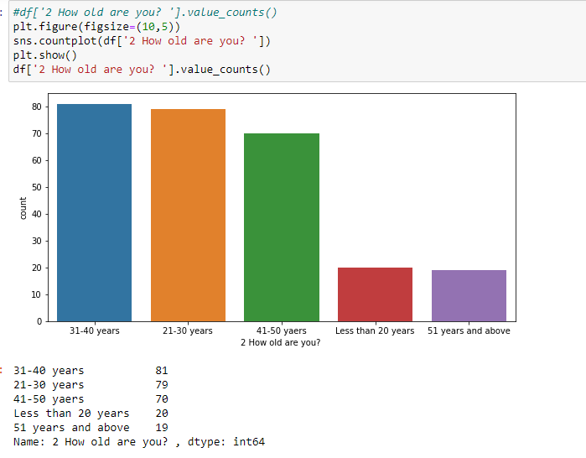
Visualizations
Most of the observations were taken from the demographic with age of 21-50 years old

Slide 8
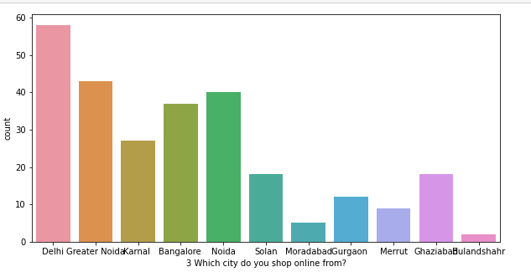
Mostly Metro cities prefer the Online shopping as compared to the smaller cities as there are multiple reason , speed of delivery being the primary one

Slide 9
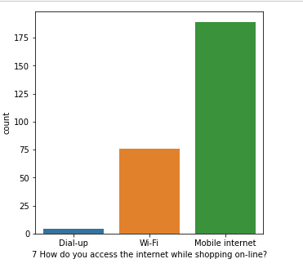
The data was rectified as we can observe that Mobile Internet was there twice , Post processing we found the very few people use dial up internet and ,most user prefer Cellular internet

Slide 10
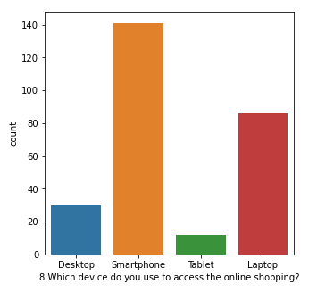
As we saw most of the users prefer to use cellular internet the devices like smartphone and tablet users will be more .

Slide 11
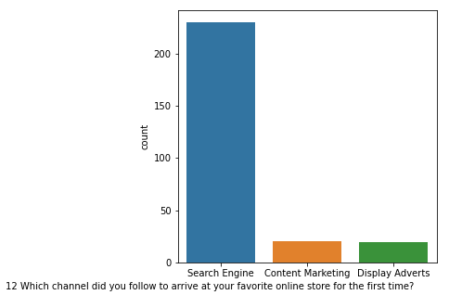
Most of the customer relies on the search engine to land up to a shopping site for the first time. Hence to attract the First time customer the SEO should be done by the websites for better visibility

Slide 12
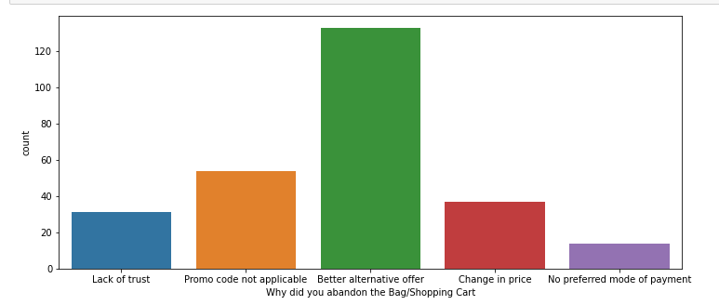
It has been observed most people abandon the cart due to availability in an alternative offer or rejection of Promo code .Thus monetary benefits plays a crucial role while shopping online

Slide 13
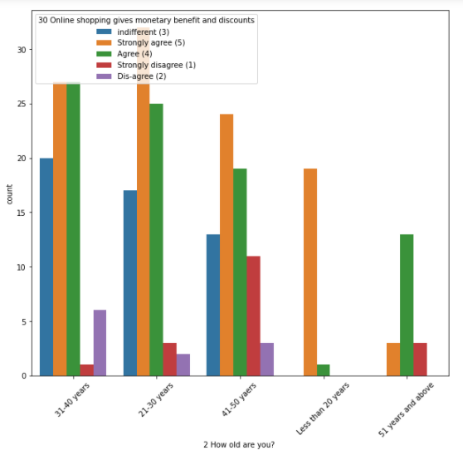
The monetary benefits is important to almost everyone, but its most important to the customers in the age range of 21-30 as mostly they are students or newly employed and pocket pinch factor is of very importance in this age .

Slide 14
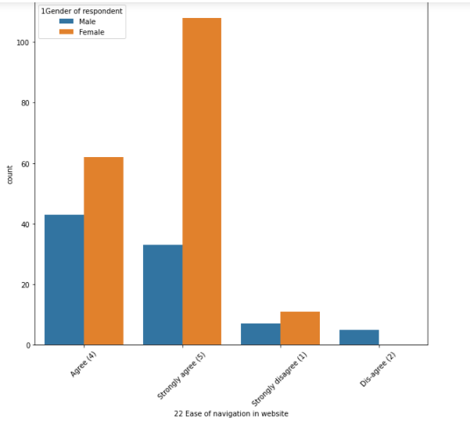
Most female customer prefer easy to navigate apps or interface as compared to male customers

Slide 15
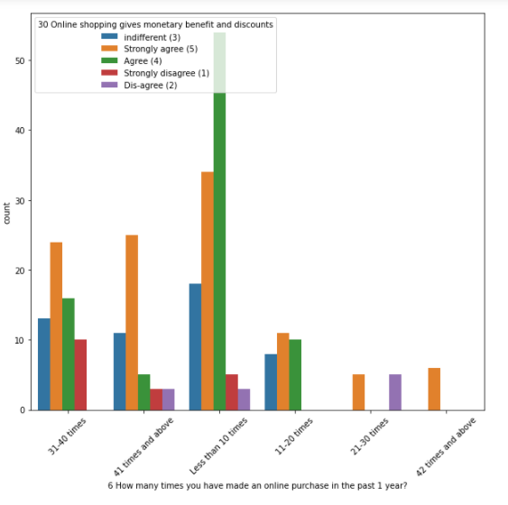
Most of the people who shop occasionally shop for monetary benefits mostly
This should be the Target audience as these consumers are ready to move from conventional systems to online only if the Monetary benefits are attractive ,which can be done via personalised sales or loyalty program

Slide 16
Interpretation of the Results
From the Statistical interpretation, following things can be inferred
Most user are using apps (android and apple)
Most user land on the site first time via Search engine
Customers primarily female prefer easy to use interface
The User base is dense in the range of 21-30 years
The customers prefer website which intimate about sale in advance so that customers can benefit more from them
The customers prefer the ecommerce platforms with a speedy delivery within competitive pricing
Customer prefer to use platforms which provide maximum discount and Credit card payment is mostly preferred by the customer as it could be saved for easy check outs
Easy returns is a very imp feature preferred by customers as it gives the freedom to choose as the size in apparel industry is semi-standardised thus a freedom on that encourages customer to buy more and return back for 2nd time
The customer with annual shopping frequency less than 10 , prefer to shop mostly for monitory benefits
The customer also prefer websites storing less data from Security point of vies
The Metro/Tier 1 cities prefer Speedy deliveries, Tier 2-3 cities prefer those customers most as the logistic coverage is high
2 Ecommerce sites does more than 70 percent of the business and have more recurring customers

Slide 17
CONCLUSION
The Customers prefer the Ecommerce channel , which provide
Easy to use interface and less loading time
Competitive discounts and Return facilities with speedy deliveries
Convenient payment options
Customer Data Privacy

